Slide 1
Internet protocol (Part 2: IP over anything)
Rocky K. C. Chang
Chung Yuan Christian University
Dept. Information and computer engineering
March 8, 2023

Slide 2
IP service model
The IP service model consists of
  an addressing scheme to identify a network interface, and
  a datagram (connectionless) model of data delivery.
H1
R1
R2
H2
IP
IP
IP
IP
IP
IP
IP
ETH
ETH
FDDI
FDDI
ETH
ETH

Slide 3
IP service model
IP provides an unreliable and connectionless (datagram) delivery service, which is often referred to as a best-effort service.
  Connectionless (vs connection-oriented):
    The IP network processes each IP packet independently.
    Destination based packet forwarding
  Unreliability (vs reliable IP): do not ensure that
    The packets will be delivered to the destination.
    The packets will be delivered to the destination correctly.
    The packets will be delivered in the same order as they were sent.
    The packets will not be duplicated.
Best-effort service was the result of design instead of default.

Slide 4
Assumptions made by IP
IP made a minimal set of assumptions about the function of that the network to be connected would provide.
  The network can transport a packet, which must be of reasonable size.
  The packets should be delivered with reasonable reliability but not perfect reliability.
  The network must have some suitable form of addressing if it is more than a point-to-point link.

Slide 5
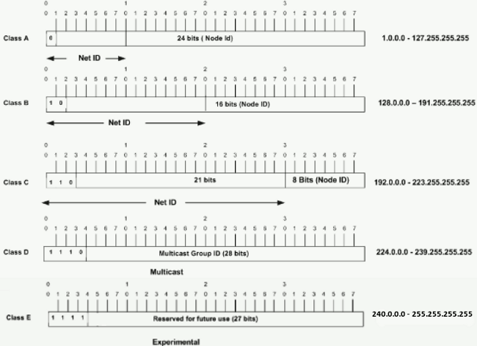
classful IPv4 addresses
A, B, C, D classes of addresses (classful addresses)

Slide 6
Special IPv4 addresses
Unicast addresses (class A, B, and C)
  Private addresses:
    192.168.0.0 - 192.168.255.255
    172.16.0.0 - 172.31.255.255
    10.0.0.0 - 10.255.255.255
  Link-local addresses:169.254.0.0 – 169.254.255.255
  Loopback addresses: 127.0.0.0/8
  6-to-4 anycast addresses: 192.88.99.0/24
  Public addresses
Broadcast addresses
  Limited (255.255.255.255)
  Subnet-directed
Multicast addresses (class D)
  Designated for special purposes
  Dynamically configured
Anycast addresses
  Unicast addresses configured in multiple network interfaces.
  IP anycasting (e.g., root DNS)

Slide 7
Exercises
Us ipconfig (or ifconfig) to find out all the IP addresses configured to all of your network interfaces.
Issue netsh interface ipv4 show addresses and netsh interface ipv6 show addresses to show all IP addresses configured to all of your network interfaces.
  What are the differences compared with the ones obtained from ipconfig?

Slide 8
Address configuration
Static vs auto configurations
Stateful vs stateless configurations
  Stateful: DHCP
  Stateless: Link local addresses (169.254.0.0/16)
    Communication within a single link
    Link-local addresses are also not routable.
    Zero configuration networking

Slide 9
IP subnets
IP subnets introduce additional levels within an IP network:
  A network address, a subnet ID, and a host ID.
IP subnets offer flexibility in allocating addresses to different sizes of sub-networks.
A subnet mask is used to indicate which bits are referred to the network and subnet ID.
  Each network interface stores subnet mask and its unicast IP address.

Slide 10
IP subnets
Subnetting for a class B address (/24)
Variable-length subnet mask
Network number
Host number
Class B address
111111111111111111111111
00000000
Subnet mask (255.255.255.0)
Network number
Subnet ID
Host ID
Subnetted address

Slide 11
IPv4 address assignment
Network 1 (Ethernet)
H7
R3
H8
H1
H2
H3
Network 4
Network 2 (Ethernet)
(point-to-point)
R1
R2
H4
Network 3 (FDDI)
H5
H6

Slide 12
exercises
What is the subnet mask for the network you are connected to?
A host’s network interface is configured with class B address 158.132.10.126, and the IP broadcast address is 158.132.11.255. Assume that only contiguous subnet mask can be used (the 1’s in the subnet mask must not be separated by 0.). Can you uniquely determine the network’s subnet mask?

Slide 13
IP supernets
Have a subnet mask shorter than the network address.
For example, use a “subnet mask” of 255.255.252.0 (/22) for
  Network 222.231.32.0
  Network 222.231.33.0
  Network 222.231.34.0
  Network 222.231.35.0
Purpose of doing this?

Slide 14
Additional internetworking issues

Slide 15
Additional internetworking issues
Bridging heterogeneous MTUs
Handling packet reordering
Error detection and reporting
Providing “differentiated” services
Packet scoping
Network diagnosis

Slide 16
Heterogeneous MTUs
Each network chooses a maximum packet size that can be sent on it, Maximum Transmission Unit (MTU). E.g.,
  1500 bytes for Ethernet and WiFi
  4352 bytes for FDDI
  17914 bytes for 16-Mbps token ring
  9180 bytes for ATM AAL5
  9000 bytes for Ethernet jumbo frames
Over-sized frames will be dropped.
All MTUs are smaller than IP datagram’s maximum size (65,535 bytes)
Problem: How to accommodate various MTU values in the Internet?

Slide 17
Heterogeneous MTUs
If MTU1 > MTU2
Minimum MTU = 576 bytes (RFCs 791 and 879)
MTU1
R
MTU2

Slide 18
exercises
Find out the MTU of your wireless interface.
  Windows: netsh interface ipv4 show subinterfaces
  MacOS: networksetup -getMTU en0
In your Wireshark capture, do you capture IEEE 802.11 frames or Ethernet frames?

Slide 19
Path MTU
Path MTU: The minimum of the networks’ MTUs on the path from a source to a destination.
Path MTU between H1 and H2 = min{MTU(N1), MTU(N2), MTU(N3)}
How to find the path MTU?
H1
N1
N2
N3
H2

Slide 20
Approaches to bridging MTUs
Problem: How can an IP datagram traverse networks with different MTUs?
  Recall that IP does not assume that all MTUs are the same.
Approaches
  Always use the minimum MTU.
  Use the local MTU first and then use the minimum MTU if it is not successful.
  Network-centric
  Host-centric

Slide 21
Hop-by-hop IP fragmentation: A network-centric approach
Transparent to the sending host
A router fragments an IP packet when forwarding it to a network with a smaller MTU.
Each IP fragment contains enough information for forwarding to the destination.
  Remember the connectionless model?
A fragmented IP datagram will be reassembled only at the destination node.
  Why not reassembled at intermediate routers?

Slide 22
Packet reordering
According to a recent study, packet reordering is a common phenomenon in the Internet today.
Packet reordering is a function of the following properties of the routing path.
  Parallel links between nodes on the path
  Exact configuration of the hardware and software in the nodes
  The load on the nodes.
Impact of reordering on TCP performance

Slide 23
Packet reordering
A1 A2 B C D
B6
B4
B3
B1
B5
C2
B2
C1
C2
C1
D1
C2
C1
A1 A2 B C D

Slide 24
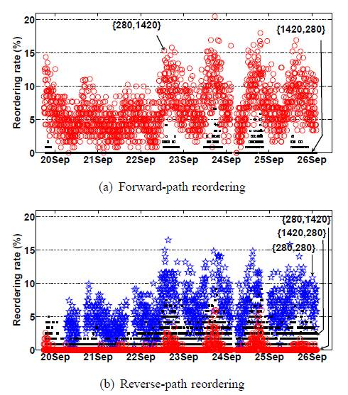

Slide 25
IPv4 datagram
0
4
8
16
19
31
V
ersion
HLen
TOS
Length
Ident
Flags
Offset
TTL
Protocol
Checksum
SourceAddr
DestinationAddr
Options (variable)
Pad
(variable)
Data

Slide 26
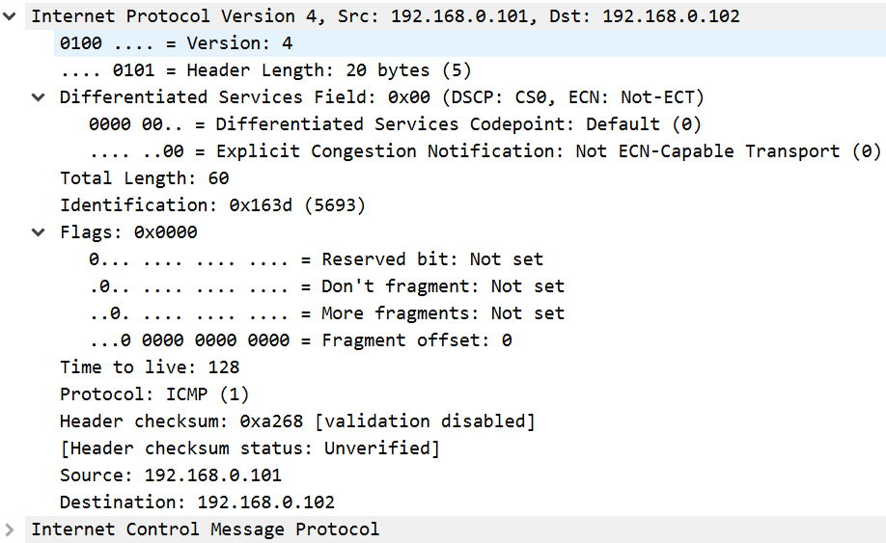
IPv4 datagram

Slide 27
IP datagram
Version: 4 for the current IP.
Type of service (TOS) for specifying how a router should handle this datagram.
Header length handles a variable-length header.
  20-byte IP header without IP options
A 16-bit length limits the size of an IP datagram to 65,535 bytes, including the IP header.
Identification, flags, and offset are used for packet fragmentation and reassembly.

Slide 28
IP datagram
Time to live (TTL) limits the number of times that a datagram processed by routers.
Protocol specifies the type of payload, e.g., 6 for TCP and 17 for UDP.
Checksum is a 16-bit word checksum.
IP options (RFC 7126), e.g.,
  Source routing
  Record route
  …

Slide 29
How to reduce the IPv4 header’s complexity?
More items in an IP header ➔ higher computation
No options
  Remove the 4-bit header length field
No hop-by-hop fragmentation in the network
  Remove the 4 bytes of identification, flags and offset.
  Instead, support end-to-end fragmentation.
No error detection for headers
  Remove the 16-bit checksum.

Slide 30
IPv6 header

Slide 31
exercises
Take a look at this IPv6 packet at https://www.cloudshark.org/captures/84fd54ad03e0
What is the total length of the packet?
What application triggered the sending of this packet?

Slide 32
packet fragmentation
To send datagrams to a directly attached host, use the network’s MTU.
To send datagrams to a nondirectly attached host, use the path MTU.
  Path MTU is the minimum of the networks’ MTUs on the path from the source to destination.
If the actual MTU used is larger than the path MTU, packet fragmentation occurs.
  Fragmentation occurs when a router attempts to forward it to a network with a smaller MTU.
  Don’t fragment bit in the IP header

Slide 33
Packet reassembly
A fragmented IP datagram will be reassembled only at the destination node.
Each fragment contains sufficient information for the packet reassembly.
  Belonging to the same original packet?
  Position of the fragment in the packet? (possible multiple fragmentations)
  The last fragment?
If any fragments do not arrive within a certain time, other received fragments in the datagram will be discarded.

Slide 34
Packet reassembly
Each fragment must share the same identity.
  The identification (IPID) field is incremented after sending an IP packet.
Each fragment should include its position in the original packet.
  Fragment offset: the offset of this fragment from the beginning of the original packet.
  Fragments are counted in units of 8 octets, why?
Need to identify the last fragment.
  If the More-Fragment bit (the last flag) is off, this fragment is the last fragment.

Slide 35
Fragmentation example
H1
R1
R2
R3
H8
ETH
IP
(1400)
FDDI
IP
(1400)
PPP
IP
(512)
ETH
IP
(512)
PPP
IP
(512)
ETH
IP
(512)
PPP
IP
(376)
ETH
IP
(376)

Slide 36
Start of header
Ident
= x
0
Offset
= 0
(a)
Rest of header
1400 data bytes
Start of header
Ident
= x
1
Offset
= 0
(b)
Rest of header
512 data bytes
Start of header
Ident
= x
1
Offset
= 512
Rest of header
512 data bytes
Start of header
Ident
= x
0
Offset
= 1024
Rest of header
376 data bytes

Slide 37
Exercises
Issue a large enough ping message (ICMP echo request) to cause IP fragmentation.
  Windows: ping -n 1 -l 2000 8.8.8.8
  MacOS: ping -c 1 -s 2000 8.8.8.8
Do you capture any packets sent from this ping?

Slide 38
Internet control message protocol (ICMP)
RFCs 792 and 950
The main services provided by ICMP are:
  Error reporting (error)
  Reachability test (query)
  Congestion control (error)
  Route-change notification (error)
  Time stamping (query)
  Subnet addressing (query)
  Router advertisement and solicitation (query)

Slide 39
ICMP messages
ICMP messages, protected by 16-bit checksums, are encapsulated in IP datagrams.
ICMP messages are classified into error messages and query messages.
  Query messages include
    echo request and reply (Ping)
    router advertisement and solicitation
    timestamp request and reply
    address mask request and reply
  The rest are error messages

Slide 40
ICMP error messages

Slide 41
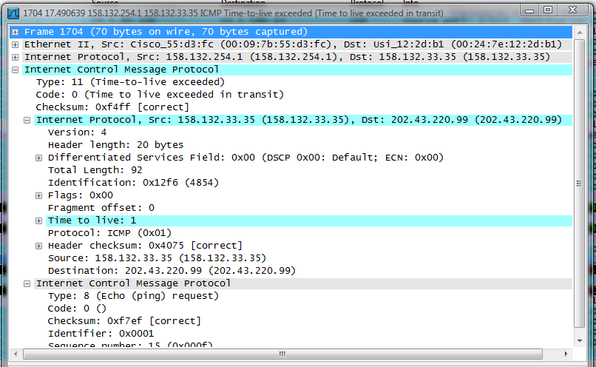

Slide 42
ICMP error messages
An ICMP error message always contains
  the IP header and the first 8 bytes of the IP datagram that caused the ICMP error to be generated.
An ICMP error message is never generated in response to
  An ICMP error message
  A datagram destined to an IP broadcast address or an IP multicast address
  A datagram sent as a link-layer broadcast
  A fragment other than the first

Slide 43
exercises
Perform traceroute from your machine to 8.8.8.8 and capture the packets. Note that the traceroute program on Windows sends out ICMP echo request messages, whereas the traceroute program on MacOS sends out UDP packets. For both cases, an ICMP Time-to-Live Exceeded error message is sent to your machine for each ICMP/UDP packet.
How many protocol headers (including Ethernet, IP, ...) are found in the ICMP Time-to-Live Exceeded packet?
How much data in the ICMP echo request message or UDP packet are included in the ICMP Time-to-Live Exceeded packet?

Slide 44
Summary
By design, IP provides the best-effort service to deliver IP datagrams on top of various networks.
Over the years, special IP addresses, IP subnetting and supernetting were proposed to solve various problems
Besides address resolution and packet encapsulation, IP also needs to handle a number of internetworking issues.
A main issue is to bridge heterogeneous MTUs
Another is to have a new protocol for querying network statuses and error reporting.
The IP datagram was carefully designed (not) to address other issues.

